Slide 1







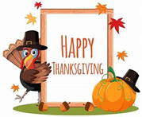
INSERT DISTRICT LOGO
Bond
NOVEMBER 2024
More Info…
All breads are whole grain
All juice is 100% fruit juice
Fresh fruits and vegetables served daily
White or chocolate milk offered each meal
All menus are subject to change
Join us for this month’s celebrations…
November 21st
Friendsgiving Meal
November 25th
Mac & Cheese Day
Eat a school lunch on November 25th and receive an Ace giveaway.
ACE Lucky Tray Day
Discovery Day!
Texas Mushrooms
Now Hiring!!
Food Service is Hiring!
Work While Kids are in School
Great Benefits
Apply online @ www.aramark.com
Friendsgiving
You Mac Me Smile
Eat a school lunch and receive an Ace giveaway
This institution is an equal opportunity provider.

Slide 2
